Slide 1
General 2D Bin Packing Problem
A difficult but interesting problem

Slide 2
Who are we?
Hoàng Trần Nhật Minh
Nguyễn Hoàng Phúc
Nguyễn Hải Long
Nguyễn Ngọc Dũng

Slide 3
Introduction
General 2D Bin Packing Problem
Ok, I got “2D”, but what is “Bin Packing”?

Slide 4
Items
A lot of “rectangle” items, generally in different sizes.
We need to transport them all.
Don’t disappoint our customers.

Slide 5
Cars
$ 50
$ 300
We have no car, so we rent some.
We can refund if we don’t use a car.
In general, the cars have different sizes and costs.
$ 950
$ 50
Seriously?

Slide 6

Rotatable for ${90}^{o}$
$ 50
$ 300
$ 950
$ 50
Cost = 300 + 50 + 50 = 400
Refund!

Slide 7
Cost and Objective
$ 50
$ 300
The total cost
= sum of rental fees of used cars
We want to minimize this cost.
Cost = 300 + 50 + 50 = 400
$ 950
$ 50
Refund!

Slide 8

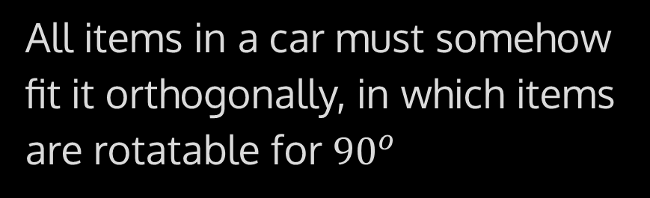
Remark
Each item has a size
Each car has a size capacity and a cost
Each item must be in one car
All items in a car must somehow fit it orthogonally, in which items are rotatable for ${90}^{o}$
Cost is the sum of fees of all used cars, minimize it

Slide 9
Fun facts! Why “General 2D Bin Packing”?
“Bin”
“2D”
“General”
In articles and papers, instead of “car”, they wrote “bin”.
The original version of this problem is one-dimensional (1D), where each item has a “weight” instead of “size”. It is already an NP-hard problem.
There are variations like:
The cost is the number of cars used (rental fee = 1)
Items are not rotatable
Which are much simpler.

Slide 10
Input specification

Slide 11




_sample_data.txt
7 3
2 3
1 5
2 2
3 2
1 4
3 2
4 1
3 5 100
4 5 150
5 6 200
n = 7: Number of rectangles
m = 3: Number of cars
Side lengths of 7 rectangles
$w_{6}=3$: Width of the 6th rectangle
$h_{6}=2$: Height of the 6th rectangle
Side lengths and costs of 3 cars
$W_{3}=5, H_{3}=6$: Width, height of the 3rd car
$c_{3}=200$: Cost of the 3rd car

Slide 12
Data generation
And properties of data

Slide 13
Define the number of rectangles
There will be 75 different input files, each of them has the number of rectangles (n) as follow:
50 easy and medium files: From 5 to 54 with step 1, i.e. 5, 6, 7, …, 54
10 hard files: From 60 to 330 with step 30, i.e. 60, 90, 120, …, 330
14 very hard and severe files: From 350 to 1000 with step 50, i.e. 350, 400, 450, …, 1000
1 sample file ☺

Slide 14
The generating algorithm for each file
Randomize rectangles
Randomly put rectangles in cars
Shrink sizes of cars
Randomly generate a few more cars and randomly assign costs for all cars
Note that the probability distribution of all random variables in this algorithm is uniform.

Slide 15
Randomize rectangles
Randomize a rectangle: each side is a random integer from 1 to 5
➞ A rectangle can be 1x1, 5x5 or any size in between
5
Repeat that for n times to obtain n rectangles
1
5
1
3
1
4
2

Slide 16
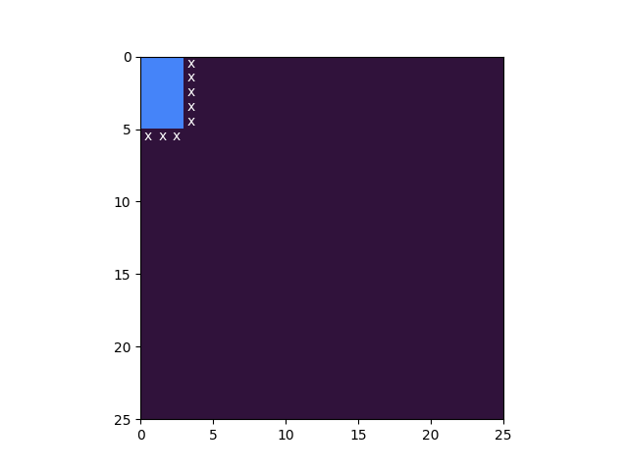
Randomly put rectangles in cars
Out of n rectangles, randomly pick from 2 to 5 rectangles
Initialize a 25x25 car (there is a mathematical reason behind it)
Put the first rectangle in the upper-left corner
Mark any place that is next to the right or lower bound of the rectangle

Slide 17
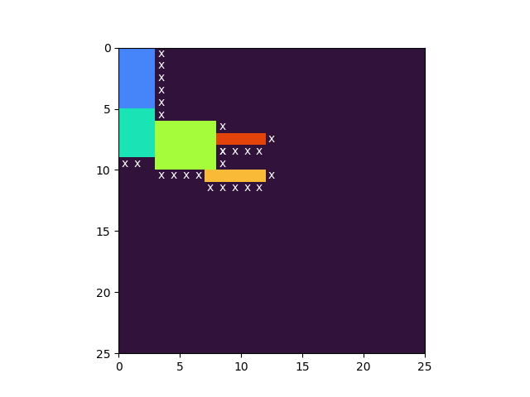
Randomly put rectangles in cars
Out of the rectangles left, choose one and randomly put it in any marked place
Repeat the step above until there is no rectangle left (from 1 to 4 times of repetition)

Slide 18

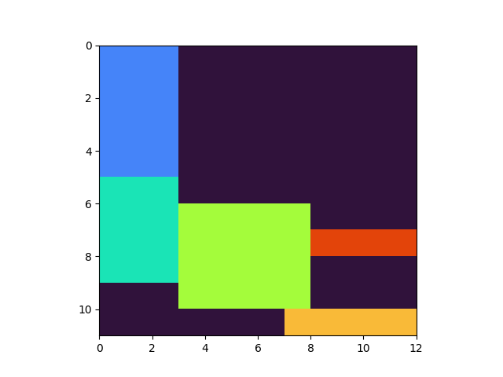
Shrink sizes of cars

Slide 19
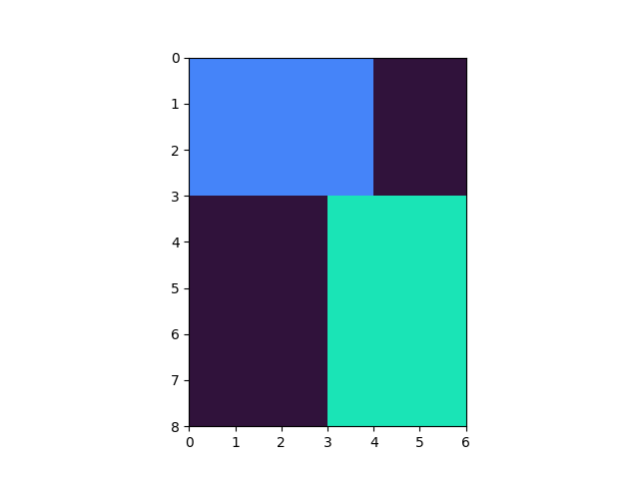
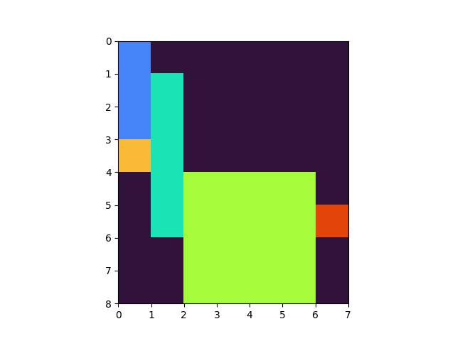
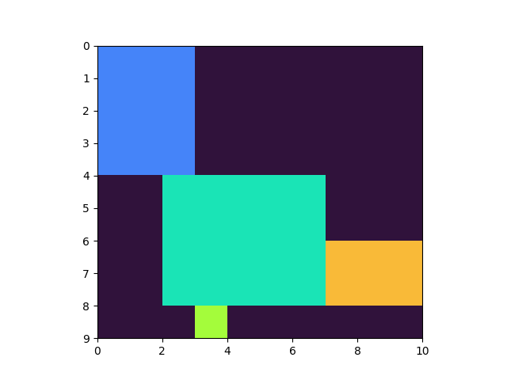
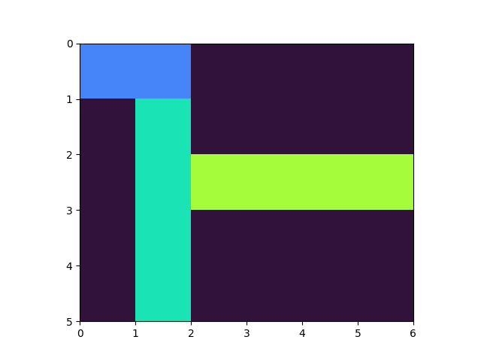
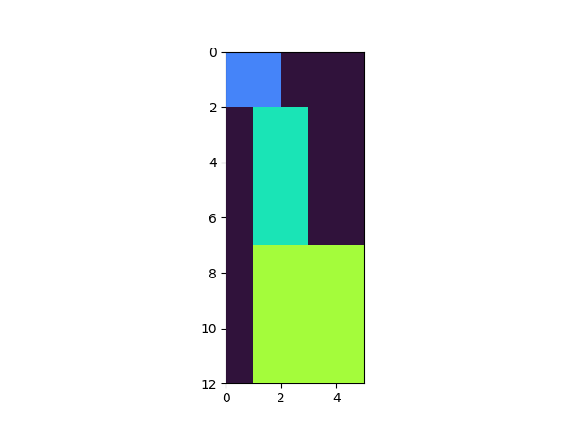
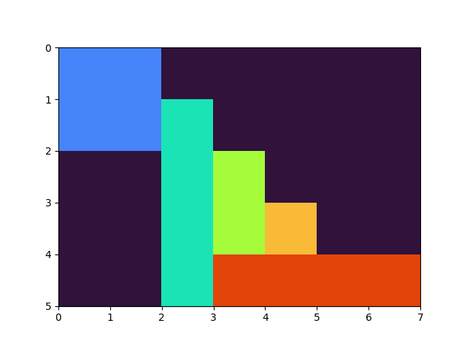
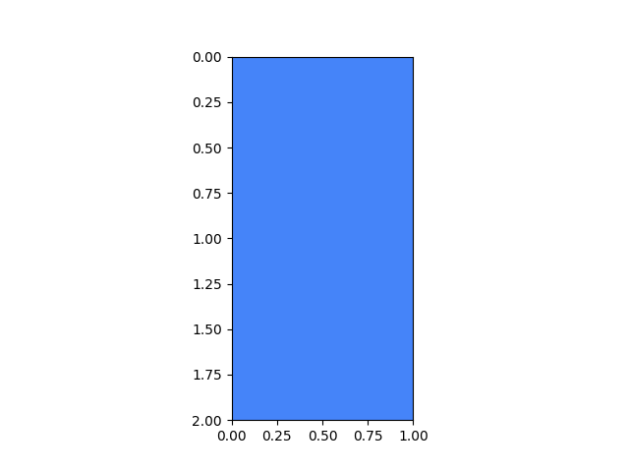
Some cars of 0030.txt

Slide 20
Randomly generate a few more cars and randomly assign costs for all cars
Randomly generate a few more cars:
Random each side of each car: From 1 to 25
➞ A car can be 1x1, 25x25 or any size in between
“A few” = Ceil of 1/5 number of the used cars
Randomly assign a cost to every car so far:
From 100 to 1000 with step 50, i.e. 100, 150, 200, …, 1000

Slide 21
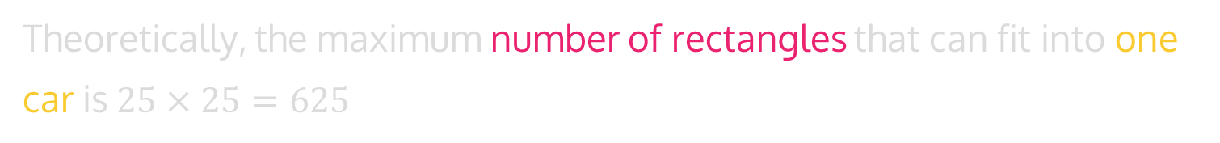
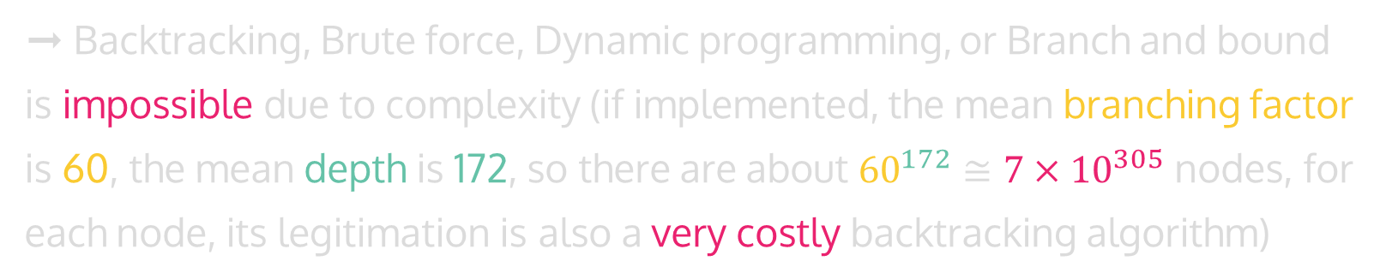
Data properties
There are a lot more cars than needed
Theoretically, the maximum number of rectangles that can fit into one car is$25×25=625$
➞ Backtracking, Brute force, Dynamic programming, or Branch and bound is impossible due to complexity (if implemented, the mean branching factor is 60, the mean depth is 172, so there are about ${60}^{172}≅{7×10}^{305}$ nodes, for each node, its legitimation is also a very costly backtracking algorithm)
Multiple “kinds” of rectangle, only with 5 different side-lengths:
Small: 1x1, Big: 5x5, Normal: 3x2, “Annoying”: 1x5, …

Slide 22
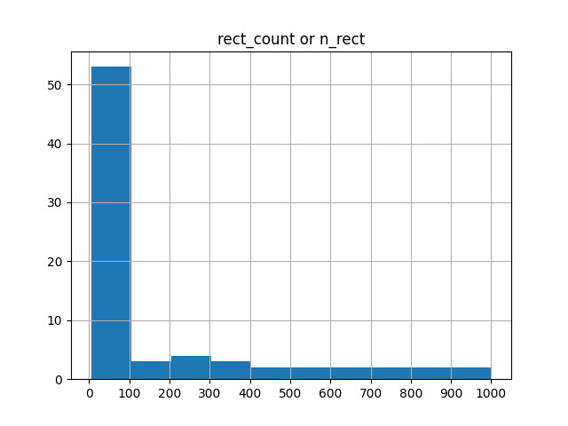
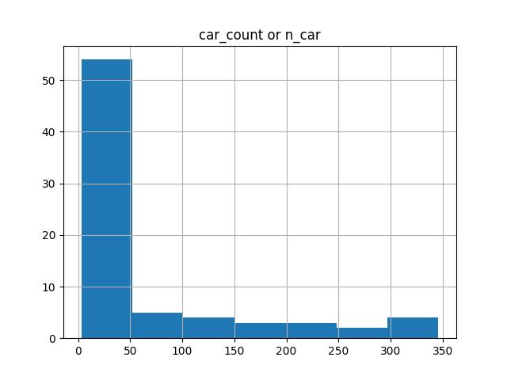
Data properties: Size distribution visualized

Slide 23
Problem Formulation
Building CP and MIP model

Slide 24
Denotation
R = {1, … , n} is the set of given rectangles
Item i has width w_{i} and height h_{i}
B = {1, … , m} is the set of available bins
Bin k has width W_{k}, height H_{k} and cost c_{k}

Slide 25
Variables
o_{i} ∊ {0, 1} represents the orientation of rectangle i
l_{i} , r_{i}, t_{i} , b_{i} are left, right, top and bottom coordinates of item i
Binary variable u_{k} is 1 iff bin k is used
Binary variable p_{ik} is 1 iff item i is placed in bin k
y_{i} = k ∊{1, … , m}, i.e. item i is placed in bin k

Slide 26
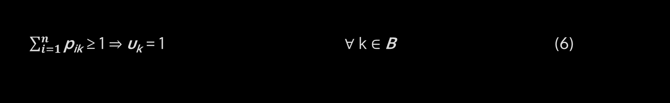
CP model - Constraints
o_{i} = 0 ⇒ r_{i} = l_{i} + w_{i} ⋀ t_{i} = b_{i} + h_{i} ∀ i ∈ R (1)
o_{i} = 1 ⇒ r_{i} = l_{i} + h_{i} ⋀ t_{i} = b_{i} + w_{i} ∀ i ∈ R (2)
y_{i} = y_{j} ⇒ r_{i} ≤ l_{i} ⋁ r_{j} ≤ l_{i} ⋁ t_{i} ≤ b_{j} ⋁ t_{j} ≤ b_{i} ∀ i, j ∈ R, i < j (3)
y_{i} = k ⇒ r_{i} ≤ W_{i} ⋀ t_{i} ≤ H_{i} ∀ i, j ∈ R, k ∈ B (4)
p_{ik} = 1 ⇒ y_{i} = k ∀ i ∈ R, k ∈ B (5)
$\sum_{i=1}^{n}{\text{p}\text{ik}}$ ≥ 1 ⇒ u_{k} = 1 ∀ k ∈ B (6)

Slide 27
Constraints
(1) If an item doesn’t rotate, its right = its left + its width and its top = its bottom + its height
(2) If the item rotates then its right = its left + its height and its top = its bottom + its width
(3) If two items are placed in the same bin, they can’t overlap each other
(4) If one item is place in a bin then its right and top coordinates can’t exceed the bin
(5) Item i is placed in bin k
(6) Bin k is used when at least one item is placed in it

Slide 28

MIP model - Constraints
o_{i} = 0 ⇒ r_{i} = l_{i} + w_{i} ⋀ t_{i} = b_{i} + h_{i} (1); o_{i} = 1 ⇒ r_{i} = l_{i} + h_{i} ⋀ t_{i} = b_{i} + w_{i} (2)
To MIP: $r_{i}=l_{i}+w_{i}∗\left(1 −o_{i}\right)+h_{i}∗o_{i} ; t_{i}=b_{i}+h_{i}∗\left(1 −o_{i}\right)+w_{i} ∗o_{i}$
y_{i} = y_{j} ⇒ r_{i} ≤ l_{i} ⋁ r_{j} ≤ l_{i} ⋁ t_{i} ≤ b_{j} ⋁ t_{j} ≤ b_{i} (3)
To MIP: $r_{i}≤M ∗\left(1 −x_{1}\right)+l_{j}; r_{j}≤M ∗\left(1 −x_{2}\right)+l_{i};$
$t_{i}≤M ∗\left(1 −x_{3}\right)+b_{j}; t_{j}≤M ∗\left(1 −x_{4}\right)+b_{i};$
$x_{1}+x_{2}+x_{3}+x_{4}+\left(1 −x_{0}\right)∗M ≥1;$
$x_{1}+x_{2}+x_{3}+x_{4}≤x_{0}∗M;b=1 −x_{00};$
$y_{j}+x_{00}≤y_{i}+M ∗x_{01}; y_{i}+x_{00}≤y_{j}+M∗x_{02};x_{01}+x_{02}≤x_{00};$

Slide 29
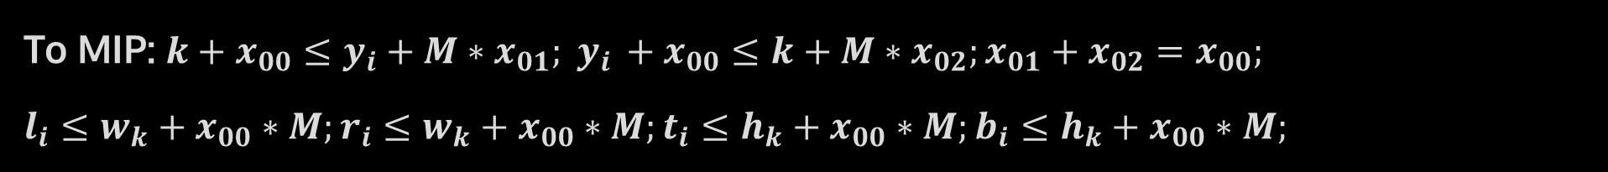
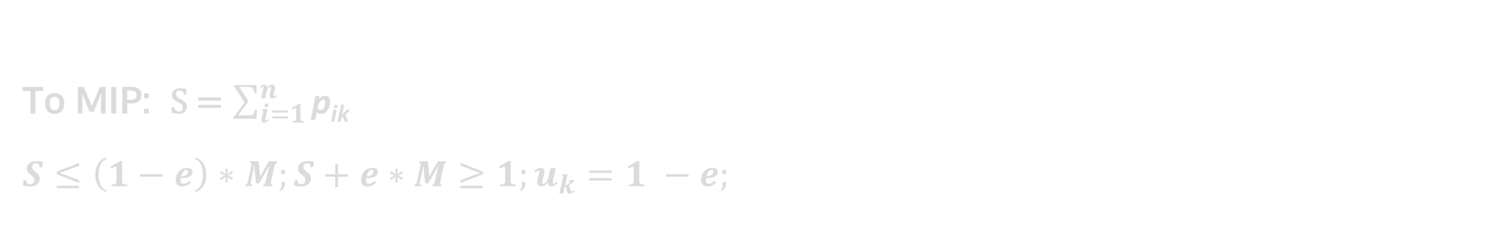
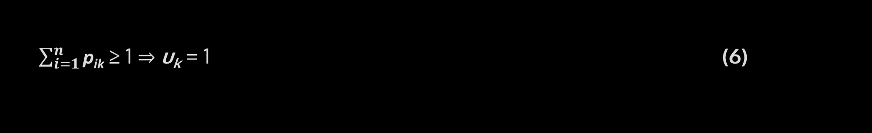
MIP model - Constraints
y_{i} = k ⇒ r_{i} ≤ W_{i} ⋀ t_{i} ≤ H_{i} (4)
To MIP: $k+x_{00}≤y_{i}+M∗x_{01}; y_{i }+x_{00}≤k+M∗x_{02};x_{01}+x_{02}=x_{00};$
$l_{i}≤w_{k}+x_{00}∗M;r_{i}≤w_{k}+x_{00}∗M;t_{i}≤h_{k}+x_{00}∗M;b_{i}≤h_{k}+x_{00}∗M;$
p_{ik} = 1 ⇒ y_{i} = k; To MIP: $y_{i}=k∗p_{ik}$ (5)
$\sum_{i=1}^{n}{\text{p}\text{ik}}$ ≥ 1 ⇒ u_{k} = 1 (6)
To MIP: S = $\sum_{i=1}^{n}{\text{p}\text{ik}}$
$S≤\left(1−e\right)∗M;S+e∗M≥1;u_{k}=1 −e;$

Slide 30
Heuristic
The quickness of heuristic + The completeness of backtracking

Slide 31
The heuristic algorithm
Sort
Best-fit (but sounds like first-fit)
“Try to contain”
Cars by “economic efficiency” (cost/area), in ascending order.
Rectangles by area, in descending order.
Note that the for loops in the next step iterate through those sorted lists.
In a car, try to contain the new rectangle along with the old rectangle(s) that are contained.
➞ Since there is no certain way to fix the places of all the rectangles, a backtracking algorithm must be run to check.
Initialize all cars, each contains no rectangle.
For each rectangle, for each car, try to contain the rectangle in the car, if the rectangle fits, contain it in the car and break the car loop (to the next rectangle).

Slide 32
But why?
Sort
Best-fit (but sounds like first-fit)
Why sort rectangles?
The best cars will be at the top of the car list.
The largest rectangles will be at the top of the rectangle list.
If we sort rectangles, there will be fewer rectangles to fit in the best cars, since: (some big + some small rectangles) < a lot of small rectangles
➞ A certain way to reduce the overall running time of the backtracking algorithm.
The largest rectangles will fit in some best cars.
When continue to iterate through next rectangles, some smaller one could fit in best cars too.
➞ Try to use the best cars as much as possible.

Slide 33
Analysis of algorithms
Practically analyze their performance

Slide 34
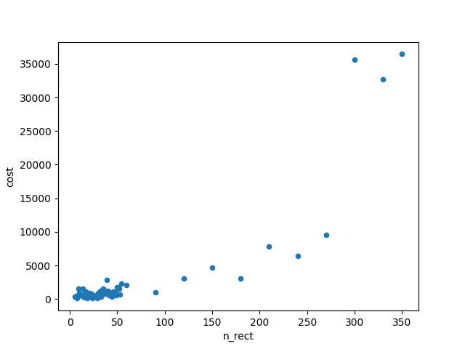
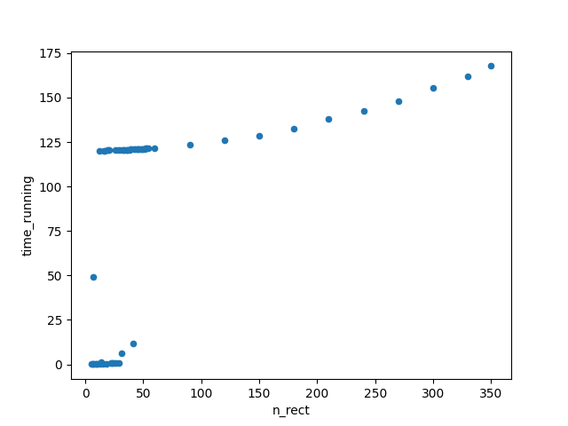
CP model
Cost
Out of 75 tests, the model can solve 62, with a 120-second time limitation
The objective values (costs) of solved instances are excellent in general
About half of the solved tests are hard enough for the algorithm to reach the time limit
Running time

Slide 35
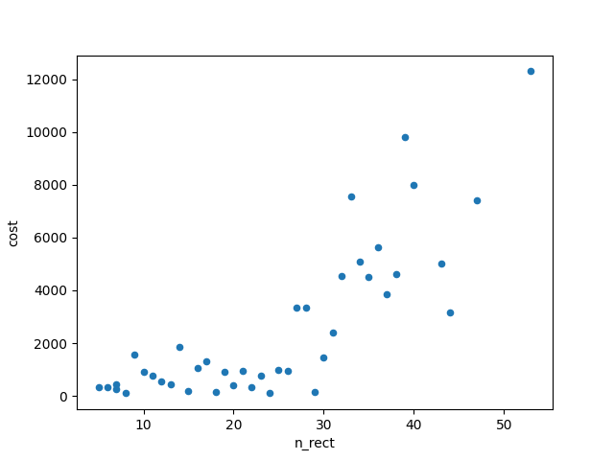
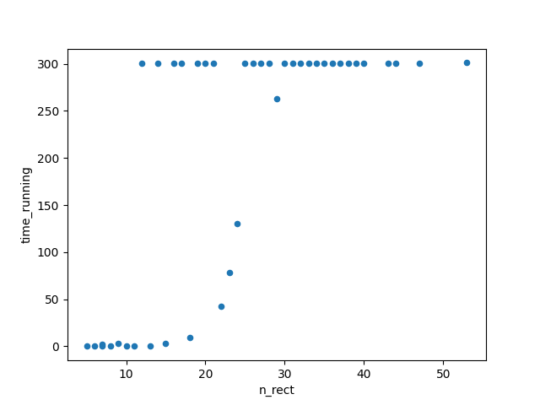
MIP model
Cost
Out of 75 tests, the model can solve 41, with a 300-second time limitation
The objective values (costs) of solved instances are excellent in general
About 2/3 of the solved tests are hard enough for the algorithm to reach the time limit
Running time

Slide 36
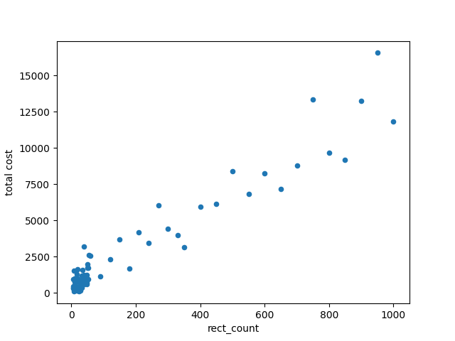
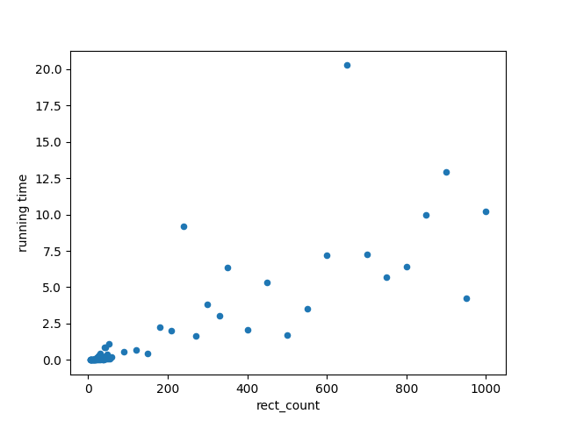
Heuristic
It can solve all 75 tests without a time limitation
Cost
The objective values (costs) of instances are good
The running time form an exponential curve with the number of rectangles (test size)
Fun fact! The test sizes here are small enough to consider that the running time is linear without big differences.
Running time

Slide 37
General 2D Bin Packing Problem
You can find interesting figures, data analysis, and even things that we tried to do in
https://github.com/htnminh/optimization-project
Thanks for your attention!

